Slide 1

Demystifying
the
Fellowship
Application Process
November 28, 2023
4-5 PM ET
HEALTHCAREARCHITECTS.ORG
Advancing Health Environments Through Design
Notes:
Welcome everyone
please mute yourself except if asking a question

Slide 2
Agenda
Welcome & Introductions
Getting Started and Categories of Nomination
Selecting a Sponsor and Submittal Questions
Submission Due Date & Confirmation
Jury and Criteria
Notification of Elevation
Ownership Of Submissions
Resubmission
What Success looks like…
Q & A
Notes:
Tracy
This webinar is being recorded. This webinar will be uploaded after today.
We have a several items to cover - Please note this is not like a pre-bid conference where each is in competition with the other – rather this is an open Q&A opportunity for everyone to benefit so please ask questions! Your questions will remain anonymous so feel free post questions in the Q&A window as we go along, and we will verbalize your question for the rest of the audience. We will also keep a Record of all Questions and after today, we will update the ACHA Website FAQ if needed.

Slide 3

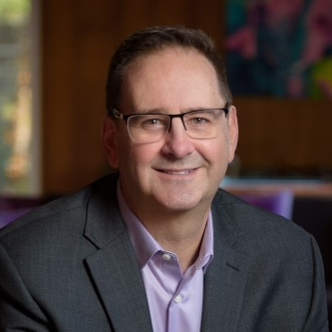
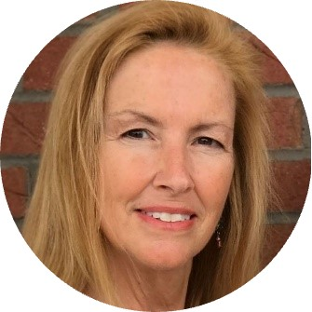
Your Presenters
John Ruffo, FAIA, FACHA
Fellowship Jury Chair
Bill Hercules, FAIA, FACHA
Fellowship Sponsor
Tracy Bond, AIA, ACHA
Awards Board Liaison
Notes:
Tracy
Make introductions and ask everyone to introduce themselves

Slide 4
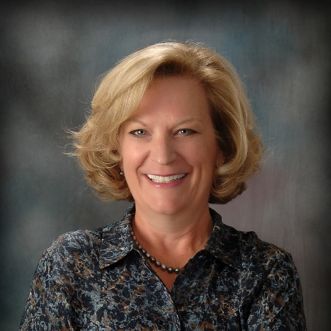
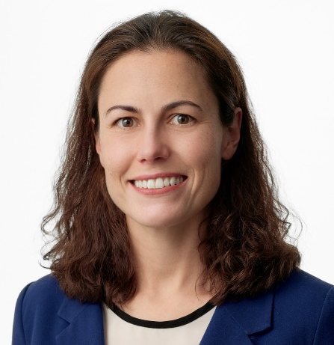


…and the FACHA Class of 2023
Ann H. Adams, AIA, FACHA
Diana Anderson, AIA, FACHA
Steve Langston, AIA, FACHA
Jill Bergman, AIA, FACHA
Notes:
Tracy
Make introductions and ask everyone to introduce themselves

Slide 5

The Council of Fellows was founded by the ACHA in order to advance the unique qualities of the profession of healthcare architecture by demonstrating and celebrating nationally significant professional achievements of its certificants.
Notes:
John
After having the CoF modeled after the AIA for 20 years, the college in 2020 decided to update the Categories of Nomination;
in addition to this first update to the categories, we continue to update the value Fellowship brings in terms of mentorship and thought leadership.

Slide 6
ACHA Fellowship is one of the highest personal honors bestowed upon a certificant of the ACHA who has shown distinction in fulfilling one specific Category of Nomination of their work, and has demonstrated individual impact in the practice of healthcare architecture.
Notes:
John
Fellowship in ACHA is recognition of meaningful and measurable contributions and impact to the discipline of healthcare architecture. This is the highest honor for an individual within our specialty of healthcare practice.

Slide 7
Fellowship is NOT a lifetime achievement award. It is intended to recognize those who have created a positive impact in the discipline of healthcare design through their body of ongoing work and contributions.
Notes:
John

Slide 8
SMALL CHANGES TO THE 2024 FELLOWSHIP PROCESS
Moved up the submission date to March 31, 2024.
Notification of elevation June 21, 2024.
Award of Fellowship at SLS in Denver in late July.
ACHA Reference Letters changed to 1 FACHA & 1 ACHA.
Upload a single PDF file to Certemy.
Notes:
Ann
Talk about the changes in 2024:
* Relative to the overall ACHA schedule date changes
* 1 FACHA Sponsor, 1 FACHA Reference Letter, 1 ACHA Reference Letter
* Single upload of file

Slide 9
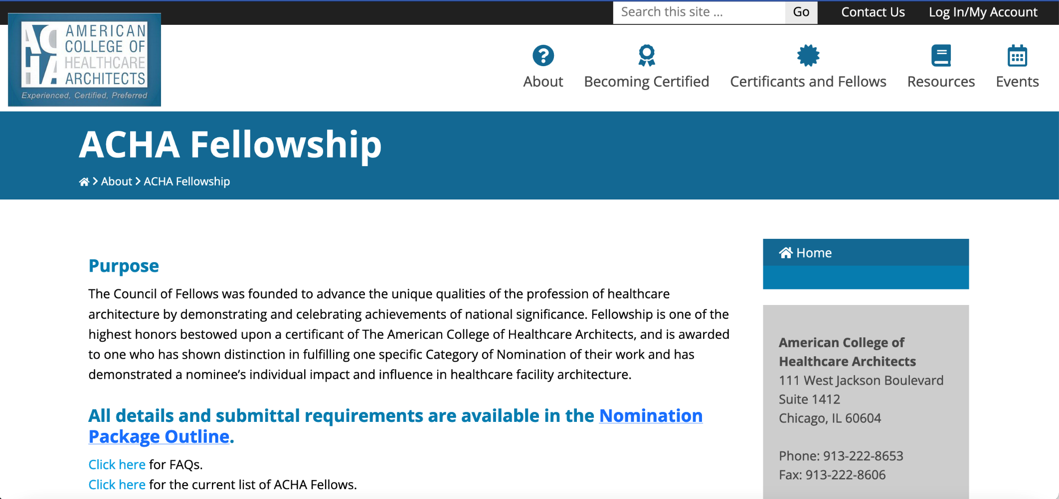
Getting Started
https://healtharchitects.org/about/acha-fellowship/
Notes:
Ann
Speaking points: Go to the on-line Application 1st

Slide 10
Qualifications
Certified for a minimum of 5 years as of July 1, 2024
Licensed Architect for a minimum of 10 years as of July 1, 2024
Show distinction in fulfilling one specific Category of Nomination over career
Notes:
Ann

Slide 11

Developing a Succinct Theme
If I was formulating a hypothesis (i.e. theory or premise) about my body of work, what would it be?
Can you define who/how/where you have had impact or influence?
Data, information, publications, statistics
What is a consistent succinct theme as to why I am selected to participate on a healthcare team?
What unique healthcare problem(s) was I hired to solve?
Notes:
John
When considering your submission, think of these four questions to get you started?
Your Succinct Theme is like an umbrella (an overarching statement) with sub-categories of support.
Full Umbrella = theme
Panels of the Umbrella = sub-topics; projects; evidence to support the succinct theme (aims or objectives)
Handle = your portfolio, role and work efforts over the course of your career; not your firm’s work or firm’s portfolio.

Slide 12
Categories of Nomination
Category One
Advanced the Art and Craft of healthcare planning and design through either:
1 A:
Superior evidence of planning and design achievements.
OR
1 B:
Superior evidence of contributions to the practice of healthcare architecture.
Category Two
Progressed healthcare environments through public service.
Notes:
John

Slide 13
Categories of Nomination
Category 1 A
Superior evidence of planning and design achievements.
Fellowship in this category is granted to those who have produced distinguished bodies of work through the practice of healthcare architecture that blends the elegance of design with superior, innovative, or highly efficient medical planning.
Notes:
John
Steve: How did you pick this theme?

Slide 14
Categories of Nomination
Category 1 B.
Superior evidence of contributions to the practice of healthcare architecture.
Fellowship in this category is granted to those who have made notable contributions through their work in a minimum of one area of expertise:
1 B.1 The research of healthcare architecture through either formal or informal investigation that has progressed the standards, specifications, building codes, materials, applications, or inventions for the field;
1 B.2 The education of healthcare architects through either formal education or mentoring that has demonstrated inspiration to others in the profession and for the field;
1 B.3 The literature of healthcare architecture through either writing or speaking that has been widely recognized to have a lasting impact for the field.
Notes:
John
Diana: How/why did you pick this theme?

Slide 15
Categories of Nomination
Category Two
Progressed healthcare environments through public service.
Fellowship in this category is granted to those who have clearly raised the standards of professional performance through leadership in the development of civic improvements, needed governmental projects, or industry organizations by advancing the professional healthcare affairs in their field.
Leadership in service to the profession and discipline of healthcare architecture
Impact as a healthcare architect within a healthcare organization
Impact as a healthcare architect within a governmental or regulatory organization
Notes:
John
Ann and Jill: How/why did you pick this theme?

Slide 16
Selecting a Sponsor
Nominees need a sponsor, who is an ACHA Fellow. They cannot be a current juror. Your sponsor’s role is:
Assist the nominee in developing a succinct theme
Ensure theme and exhibits support the Category
Write a one-page letter on behalf of the nominee
Submissions without a sponsor letter will be disqualified
Contact references and ensure appropriate letters
https://healtharchitects.org/about/acha-fellowship/
Notes:
Bill
ACHA Staff will review criteria & help you during the submitting process.
Sponsor can be from same firm – any FACHA

Slide 17
Submission Questions
If you have questions, the first source of answers should be your Sponsor.
Questions unanswerable by your sponsor can be emailed to the ACHA Executive Director, who may address them directly, or defer to the Board Liaison or clarification.
Notes:
Bill
Rule #1 go through your sponsor not a juror

Slide 18
Submission Due Date
Submissions are due on-line no later than 5 PM ET:
March 31, 2024
We strongly urge submissions be uploaded well in advance.
Notes:
Tracy
ACHA will blast an e-mail in mid-April as a reminder; the platform is Certemy.

Slide 19
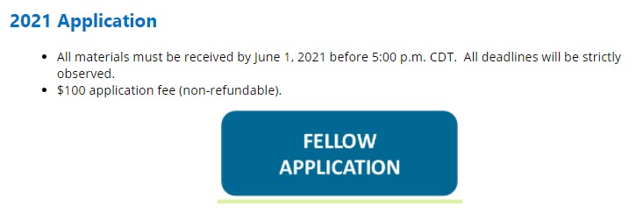
Submission Confirmation
All submissions will be uploaded electronically through Certemy.
2024 Application
All materials must be received by March 31, 2024, before 5:00 PM ET. All deadlines will be strictly observed.
$100 application fee (non-refundable).
Notes:
Tracy
In Certemy, each step is a red, yellow, or a green light system similar to recertification.

Slide 20

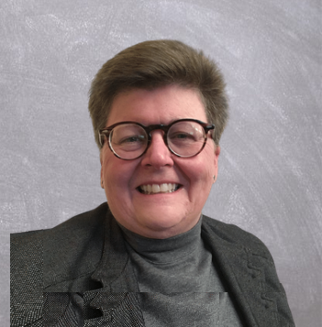

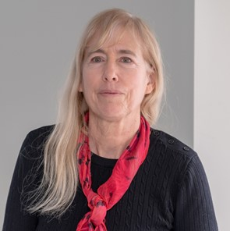

2024 Jury
TBD, FACHA
Molly Scanlon, FACHA
John Ruffo, FACHA
Jury Chair
Mardelle Shepley, FACHA
Charles Griffin, FACHA
Notes:
Tracy
By ACHA Policy & Procedures: “A favorable vote of 3 of the 5 jurors is required to elevate a certificant to Fellow.”

Slide 21
Evaluation Criteria
Distinction within the Category of Nomination
The jury shall interpret the qualities of excellence, influence, impact, and quality of presentation for the Category of Nomination.
Maintain consistency of evaluation qualities as applied through the history of this award program.
The jury will not add any criteria to the evaluation process.
Notes:
John

Slide 22
Evaluation Criteria
The work of the jury is inherently subjective in part and necessarily requires interpretation, while maintaining consistency with past judgements and outcomes.
The jury will focus their attention on the submission alone, which shall demonstrate the individual impact through a balanced presentation of achievements, exhibits, and references.
Successful nominees must receive at least 60% jury affirmation.
Notes:
John

Slide 23
Deliberation Record
The Board liaison will compile a summary of Jury’s recommendations.
Nominees, sponsors, and other interested parties are expressly instructed to not approach the jury to discuss the deliberations of their submissions.
Notes:
Tracy

Slide 24
Notification
Once a jury reaches their recommendation, the Board of Regents formally approves and confers Fellowship.
Upon Board approval, the ACHA president will communicate to successful nominees by phone and letter, and to unsuccessful nominees by general letter.
All correspondence shall be also copied to the nominee’s FACHA sponsor.
All communications will happen simultaneously.
The timing of such notifications will be before 21 June 2024
Notes:
Tracy
The timing is much earlier this year as the elevations will occur at the Summer Leadership Summit in late July.

Slide 25
Ownership of Submissions
Upon submission, all packages become the property of the American College of Healthcare Architects for use, as it deems appropriate.
As such, the contents of the submissions must be free from any copyright.
Notes:
Tracy

Slide 26
Resubmission
Previous nominees may re-submit another package.
If a nominee is denied advancement after three consecutive award cycles, that nominee must wait two additional award cycles prior to resubmission, and will be considered as a first-year submission.
Notes:
Tracy
The world doesn’t end – normally submissions are very close – go beyond just the world you see to what can be influenced. We encourage re-submittal if you weren’t successful the first time.

Slide 27
Success looks like…
Look at successful candidates application on ACHA website
Be clear about your Fellowship category of nomination and frame your response accordingly
Structure application in exact order of the application and answer the questions that are asked;
It is suggested to have your clients sign your declaration of responsibility in your “exhibits”
Common to all categories is about INFLUENCE/IMPACT = Credentialed is not the pathway to fellowship! Must exhibit Influence/Impact
Notes:
Bill
Go to website & look at another candidate’s application;
Be clear about your category nomination;
Structure application in EXACT order of the application AND answer the questions that are asked;
Preference clients sign your declaration of responsibility in your “exhibits”
Common to all categories is about INFLUENCE/IMPACT = Credentialed is not the pathway to fellowship! Must exhibit Influence/Impact

Slide 28

Questions?
Notes:
Bill as Moderator for Class of 2023

